Slide 1
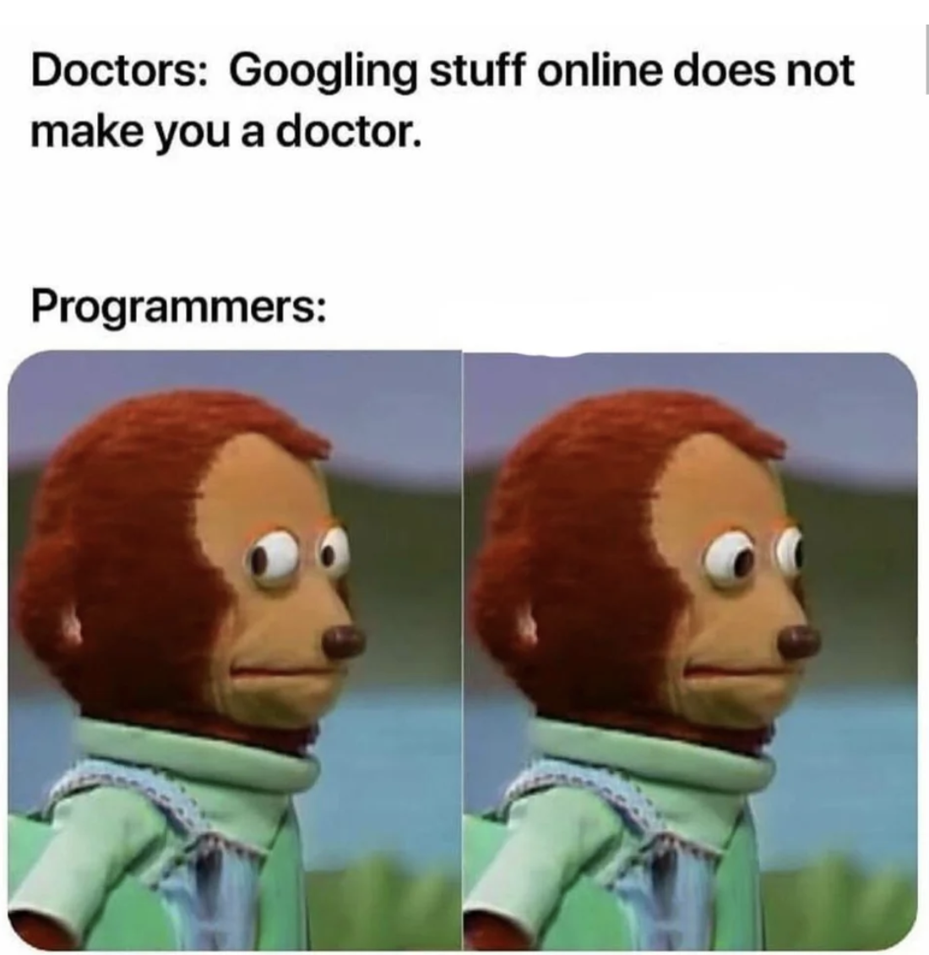

Slide 2
Lecture 0.0: Introduction
CS2308
Gentry Atkinson

Slide 3
Meeting Times
Monday-Firday 10:00-11:40am
In-person lectures.
Office hours on Zoom:
  Check “Announcements” for those links.

Slide 4
Who Am I?
Gentry Atkinson
Adjunct and recently graduated PhD.
My research focus is in machine learning and I’m always happy to talk about it.
gma23@txstate.edu
  Please contact me through email rather than through Canvas.
Office hours: TBD

Slide 5
Required Materials
Textbook: Tony Gaddis, Starting out with C++: From Control Structures through Objects
  8^{th,} 9th, or 10th edition is fine
  Reference copy available in Alkek
IDE: your choice. CodeBlocks is still “official”
Bringing a laptop or tablet to class is a good idea but not required for lectures.
You will need a laptop or tablet in class for exams.

Slide 6
What Will We Cover?
Algorithms and algorithmic efficiency.
Pointers and pointer operations.
Dynamic memory allocation.
Library creation.
Classes and object orientation.
Programming in a Unix (or Linux) environment.

Slide 7
Grading
Exams: 40%
Coding Projects (4): 40%
In-Class Assignments: 10%
Independent Quizzes: 10%
Pre-req “exam” is available today

Slide 8
Pre-Term Exam
Worth 5% of overall grade.
Review of CS1428 material.
Multiple choice, on Canvas, and on your own time.
Students who are not happy with their grades on this exam can raise them with a small “Coding Project 0”.

Slide 9
Coding Projects
Use a design document to implement a piece of software.
One week of working time for each project.
Students can discuss these projects with each other, but you must list your collaborators in you authorship comments.
Everyone should submit their own copy of their own assignment (even if the code is identical).

Slide 10
Academic Honesty
Submitting someone else’s code as your own is always plagiarism. Cite your sources and do not use homework/exam solutions from the internet.
Do not post homework/exam questions or solutions. It doesn’t help anyone learn and makes more work for me.
I will post some slides on citing code on Canvas.
Code from other students’ past assignments (e.g. Chegg) should never be submitted for an exam or assignment.

Slide 11
Important Dates
May 31st: last day to add a class
June 2nd: last day to drop w/o grade
June 17th: last day to drop with a ‘W’
June 30th: final exam

Slide 12
Extra Credit
There are 5 extra credit problems available in this class.
Each one is worth one point on your final grade.
The problems are on HackerRank (which is a great source of coding challenges).
The specific problems and instructions for submitting solutions will be posted on Canvas.
There is no other extra credit.

Slide 13
Questions or Comments?
(also read the syllabus)

